Slide 1
Temporal Correlation Analysis
Kamala Natarajan

Slide 2
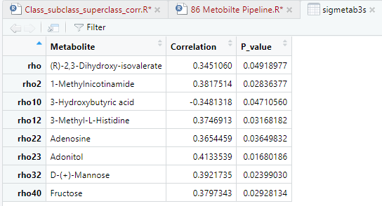
Significant Metabolites 0-3 Days from Spearman Correlation Analysis

Slide 3
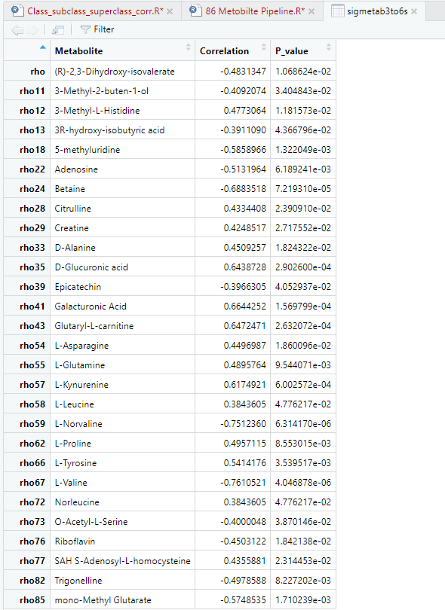
Significant Metabolites 3-6 Days from Spearman Correlation Analysis

Slide 4
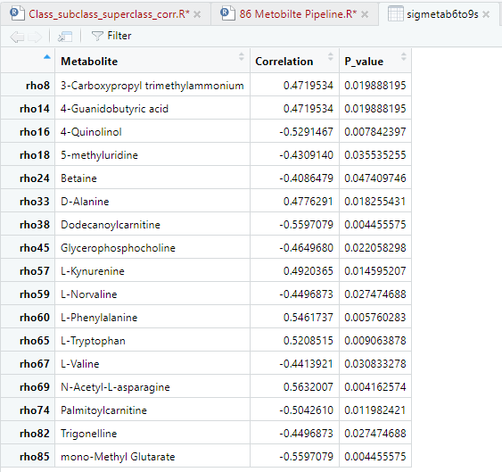
Significant Metabolites 6-9 Days from Spearman Correlation Analysis

Slide 5
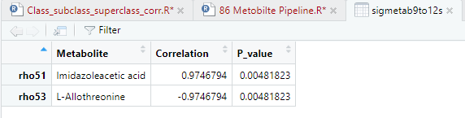
Significant Metabolites 9-12 Days from Spearman Correlation Analysis

Slide 6
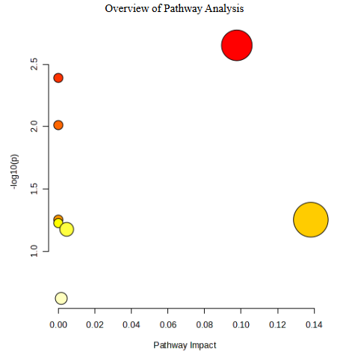
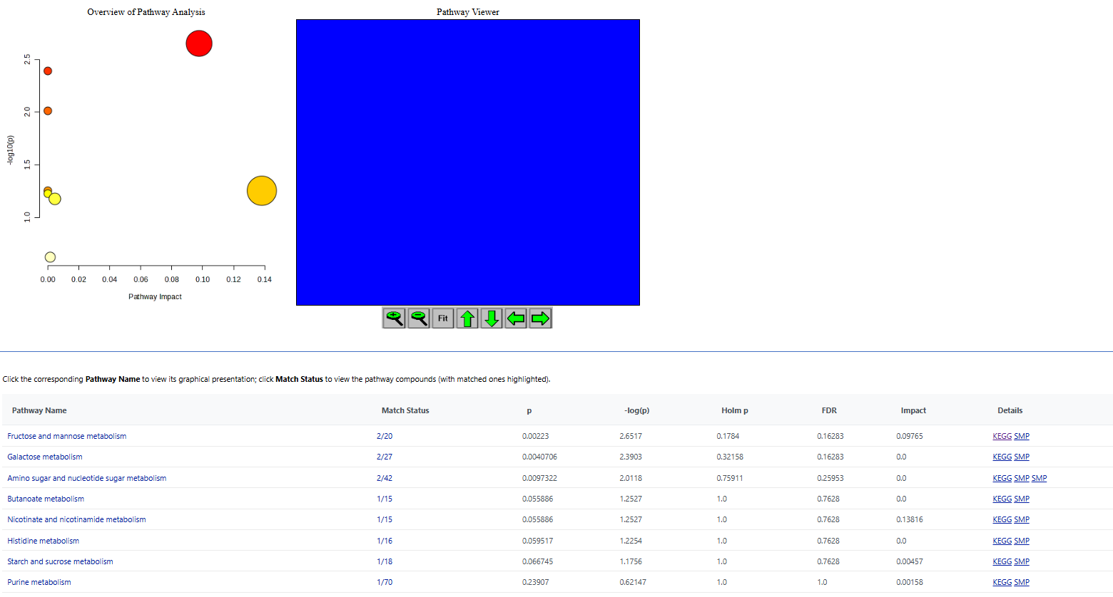
Pathway Analysis ( 0-3 ) Days- Kegg
All three pathways have Fructose and D-Mannose as their compounds in their Kegg pathway database

Slide 7
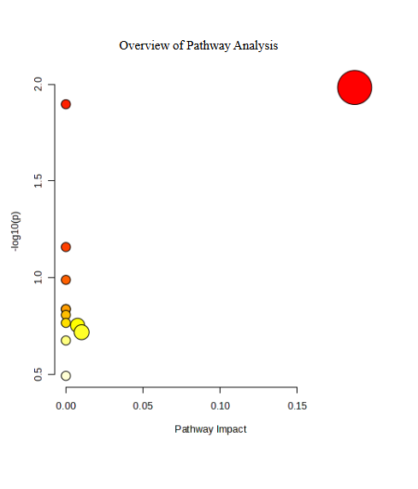
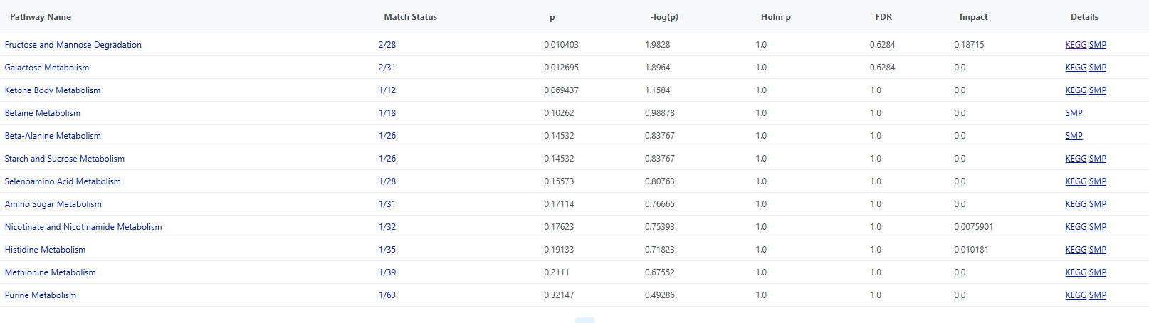
Pathway Analysis ( 0-3 ) Days- SMPDB
The two pathways have Fructose and D-Mannose as their compounds in their SMPDB pathway database

Slide 8
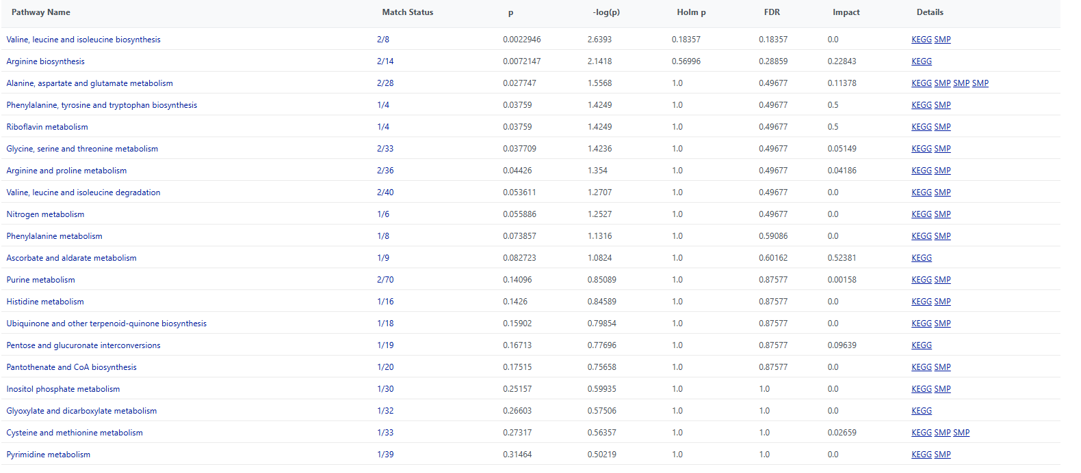
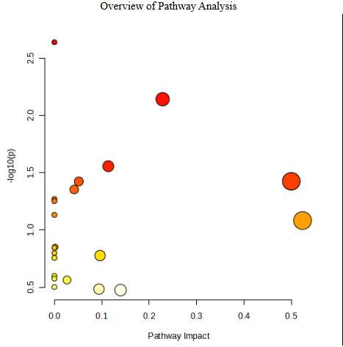
Pathway Analysis ( 3-6 ) Days- Kegg
-Valine leucine isoleucine biosysnthesis: Valine, Leucine
-Arginine Biosynthesis: L-Citrulline, L-Glutamine
-Alanine, aspartate and glutamate metabolism: Asparagine, Glutamine
-Phenylalanine, tyrosine and tryptophan biosynthesis: Tyrosine
-Riboflavin metabolism: Riboflavin
-Glycine, serine and threonine metabolism: Betaine, Creatine
- Arginine and Proline Metabolism: Creatine, Proline

Slide 9
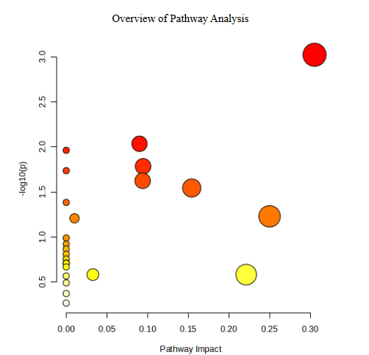
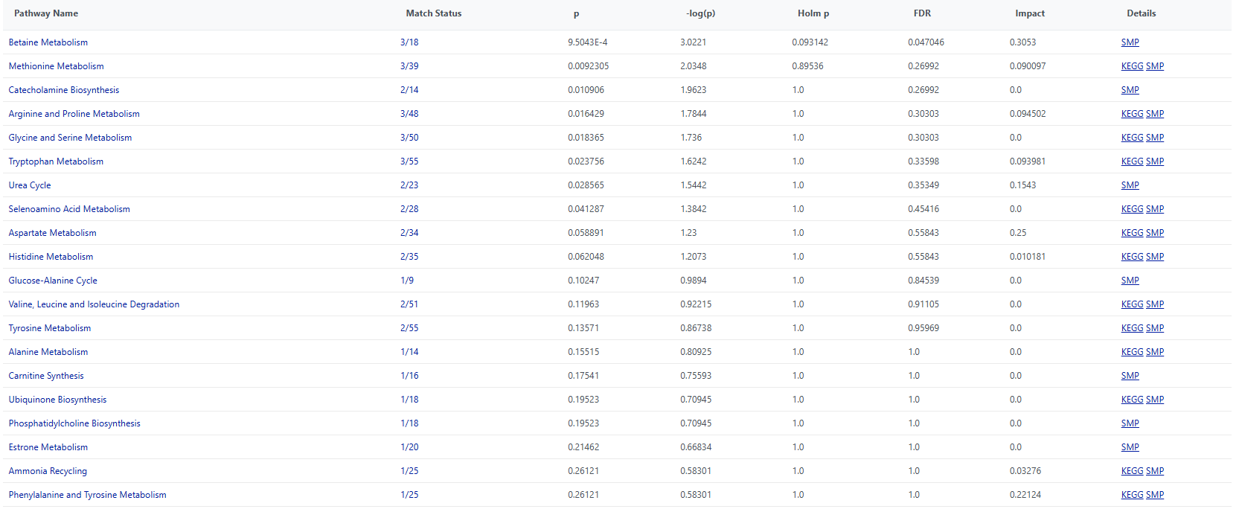
Pathway Analysis ( 3-6 ) Days- SMPDB
-Betaine Metabolism: Betaine, SAH, Adenosine
-Methionine Metabolism: SAH, Adenosine, Betaine
-Catecholamine Biosynthesis: L-Tyrosine, SAH
-Arginine and Proline Metab: Citrulline, SAH, Creatine
-Glycine and Serine Metab: Alanine
Tryptophan Metab: Alanine, Kynurenine, SAH
-Urea Cycle: Alanine, Citrulline
- Selenoamino Acid Metabolism: Alanine, Adenosine

Slide 10
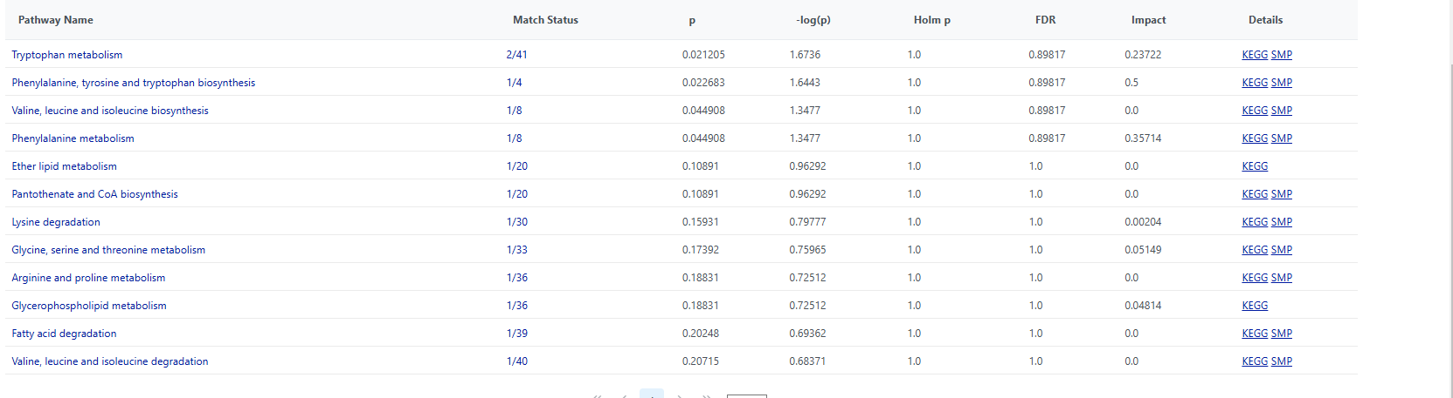
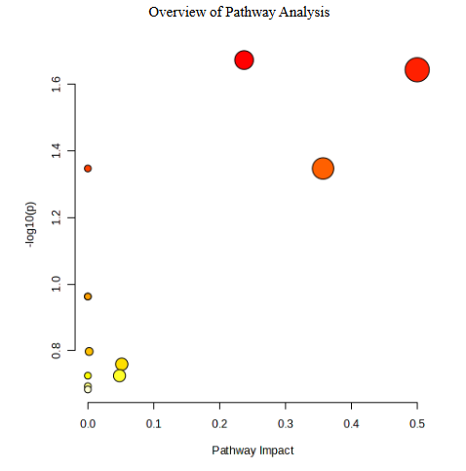
Pathway Analysis ( 6-9 ) Days- Kegg
-Tryptophan Metabolism: L-Tryptophan, L-Kynurenine
-Phenylalanine, tyrosine and tryptophan biosynthesis: L-Phenylalanine
-Valine, leucine and isoleucine biosynthesis: L-Valine
-Phenylalanine metabolism: L-Phenylalanine

Slide 11
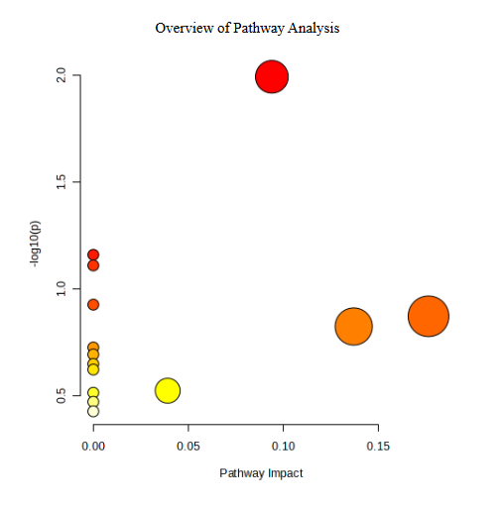
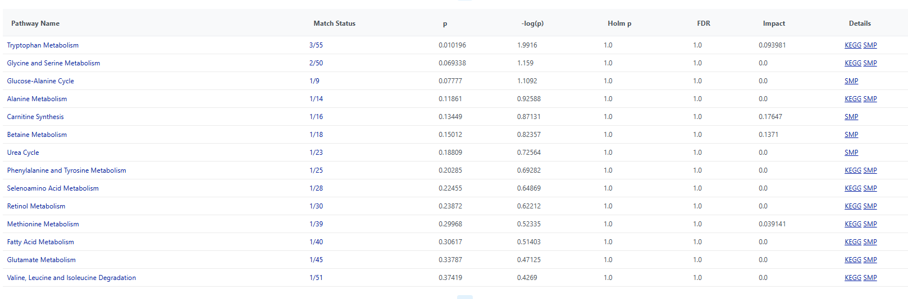
Pathway Analysis ( 6-9 ) Days- SMPDB
Tryptophan Metabolism: L-Tryptophan, D-Alanine, L-Kynurenine

Slide 12
Pathway Analysis 9-12 (Kegg and SMPDB)
None found.

